Slide 1

Fuzzy inference system to identify mobile fraudulent transactions
CRISTIAN ALZATE URREA

Slide 2

Motivation
Problem: Mobile fraudulent transactions are a growing threat affecting individuals, businesses, and financial institutions.
Challenge: imbalanced data distributions, where fraudulent cases are significantly fewer.
Approach: Fuzzy systems offer promise by leveraging expert knowledge

Slide 3
System variable
 | Universe discurse | Categories
Withdrawal percentage | [0,1] | Low: [0,0.3) Medium: [0.3,0.7) High: [0.7,1]
Hour | [0, 24) | Early Morning: [0,6.5) Day: [6.5,16.5) Night: [16.5,24)
Transactions per day | [0, 50] | Low: [0,5] High: (5,50]
Transactions per month | [0, 50] | Low: [0,40) High: [40,50]
Risk | [0,1] | Low: [0,0.3) Medium: [0.3,0.7) High: [0.7,1]

Slide 4
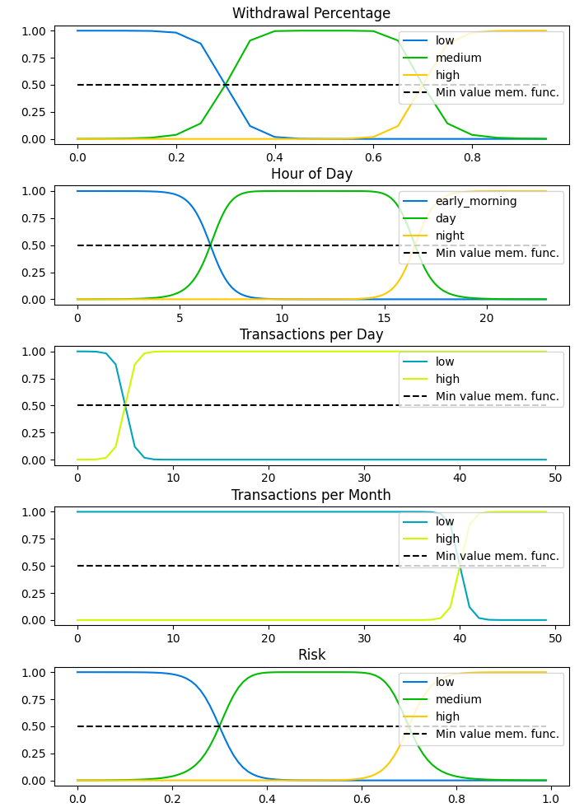
Membership function

Slide 5
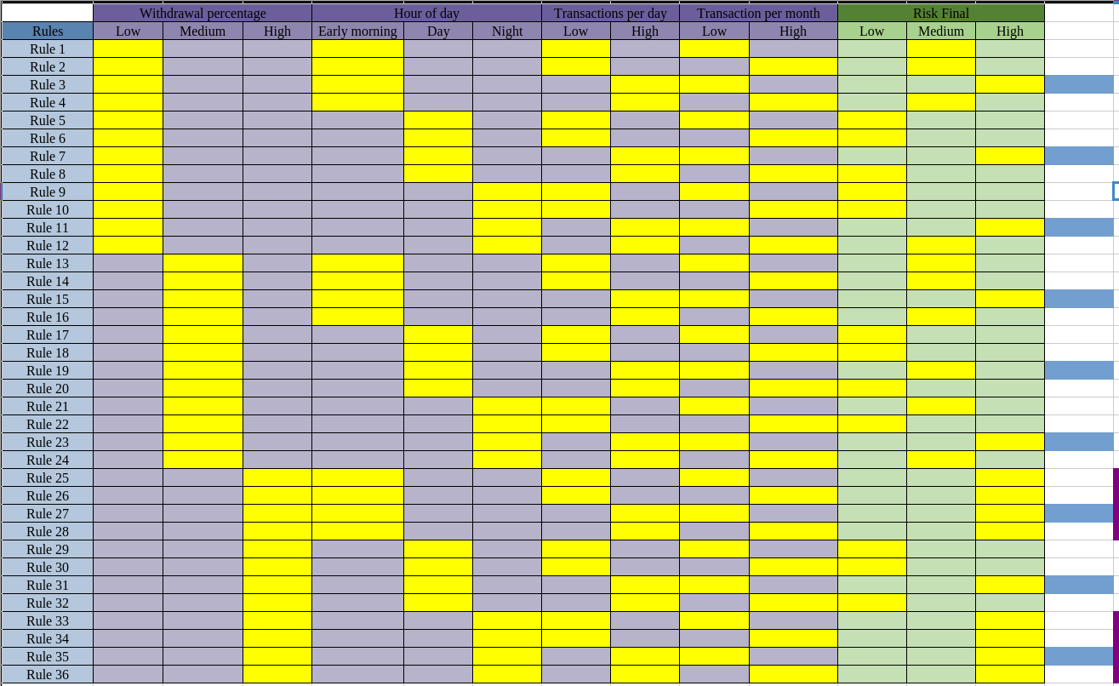
T-norms: min, algebraic product.
S-norms: max, algebraic sum
Rules definition
36 Rules

Slide 6
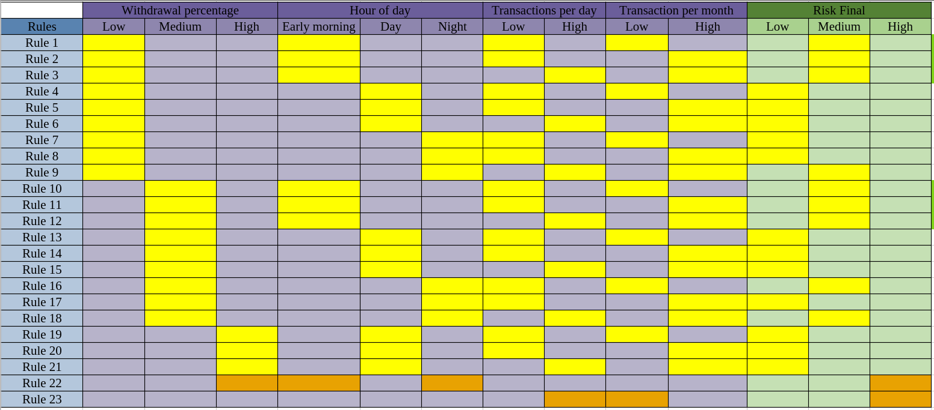
Rules definition
23 Rules
If the withdrawal percentage is high and the hour is early morning or night , then the risk is high.

Slide 7
Rules definition
23 Rules
If transactions per day is high and transactions per month is low, then the risk is high.

Slide 8
Comparion of decision surface
T-norms: min, algebraic produc
S-norm: max, algebraic sum
Inputs: 0.7, 9, 5, 20

Slide 9
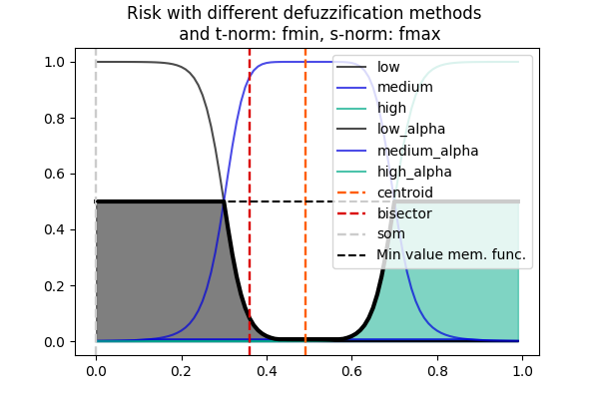

Comparion of decision surface
T-norms: min, algebraic produc
S-norm: max, algebraic sum
Inputs: 0.7, 9, 5, 20

Slide 10
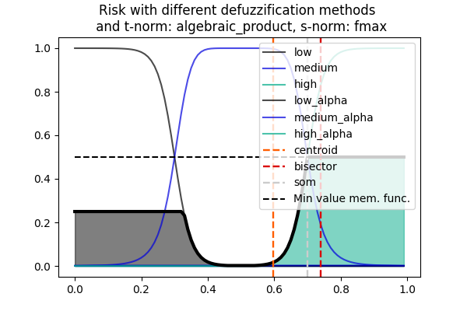

Comparion of decision surface
T-norms: min, algebraic produc
S-norm: max, algebraic sum
Inputs: 0.7, 9, 5, 20

Slide 11
Comparion of response surface

Slide 12
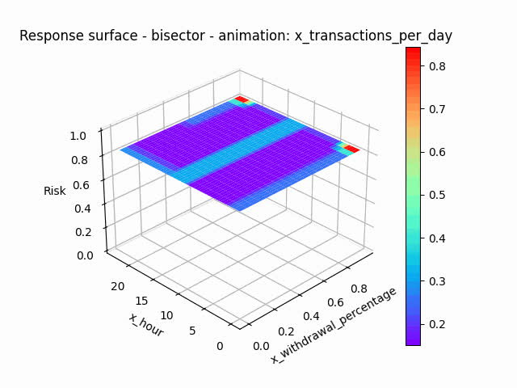
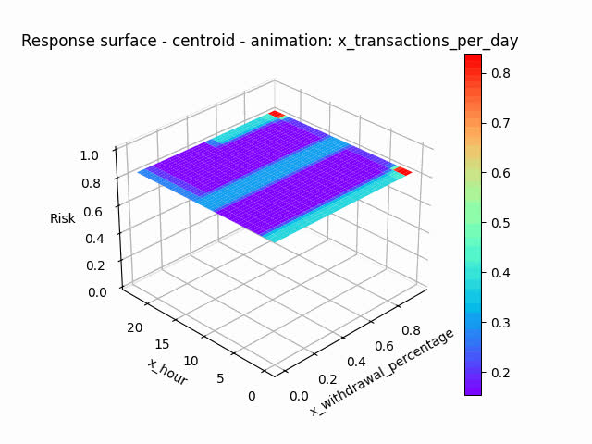
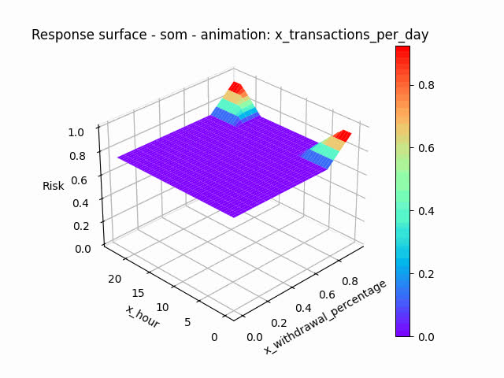
Comparion of response surface
T-norms: fmin
S-norm: algebraic sum

Slide 13
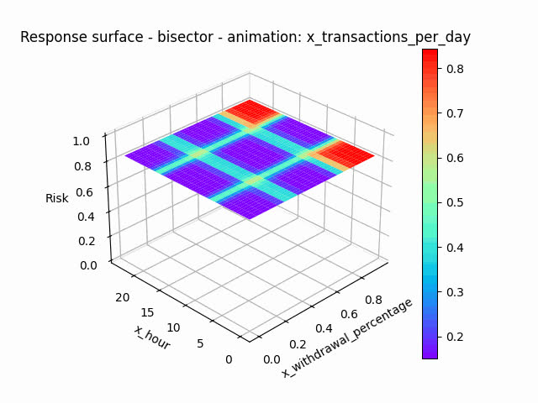


Comparion of response surface
T-norms: algebraic produc
S-norm: algebraic sum

Slide 14
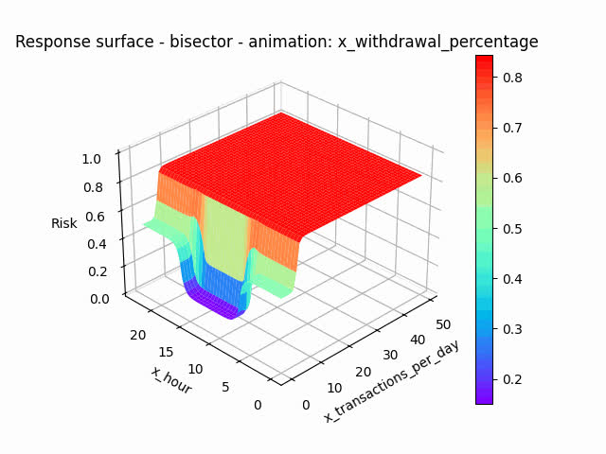
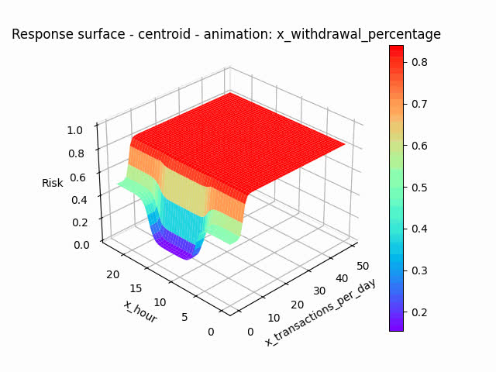
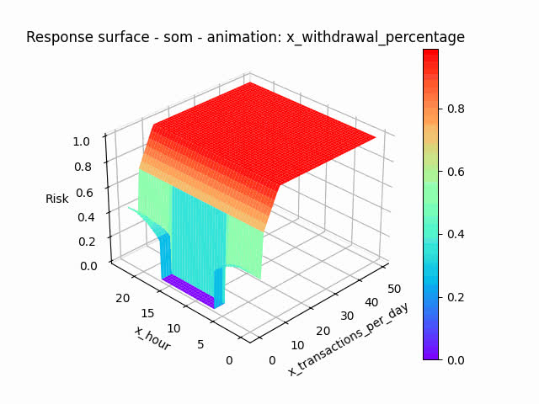
Comparion of response surface
T-norms: algebraic produc
S-norm: algebraic sum

Slide 15
CONCLUSION
Changing the defuzzification method alters the model estimation.
Variables such as transactions per day or hour have a strong influence on risk.
The work can be extended to the Neuro-Fuzzy Expert System, as it can improve the identification of unusual behaviors.

Slide 16
REFERENCES
Monto máximo de pagos - centro de ayuda bancolombia.https://www.bancolombia.com/centro-de-ayuda/preguntas-recuentes/monto-maximo-pagos. Accessed: February 18, 2024.
Sikdar Md S Askari and Md Anwar Hussain. Ifdtc4. 5: Intuitionistic fuzzy logic based decision tree for e-transactional fraud detection. Journal of Information Security and Applications, 52:102469, 2020.
Tanmay Kumar Behera and Suvasini Panigrahi. Credit card fraud detection using a neuro-fuzzy expert system. In Computational Intelligence in Data Mining: Proceedings of the International Conference on CIDM,10-11 December 2016, pages 835–843. Springer, 2017.
Jisha Shaji and Dakshata Panchal. Improved fraud detection in ecommerce transactions. In 2017 2nd International Conference on Communication Systems, Computing and IT Applications (CSCITA), pages121–126. IEEE, 2017.

